Slide 1

Laravel Lifesavers
Spatie Packages you may need

Slide 2
LARAVEL BACKUP | LARAVEL ACTIVITY LOG
LARAVEL MEDIALIBRARY | LARAVEL QUERY BUILDER
LARAVEL TRANSLATABLE | LARAVEL SIGNAL AWARE COMMAND
LARAVEL TAGS | LARAVEL HONEYPOT
 | LARAVEL SCHEMALESS ATTRIBUTES
REGEX | LARAVEL PDF
LARAVEL HEALTH | LARAVEL SCHEDULE MONITOR
 | LARAVEL WEB TINKER
LARAVEL RESPONSECACHE | LARAVEL QUICK LOGIN
OPENING HOURS

Slide 3


Slide 4


Slide 5
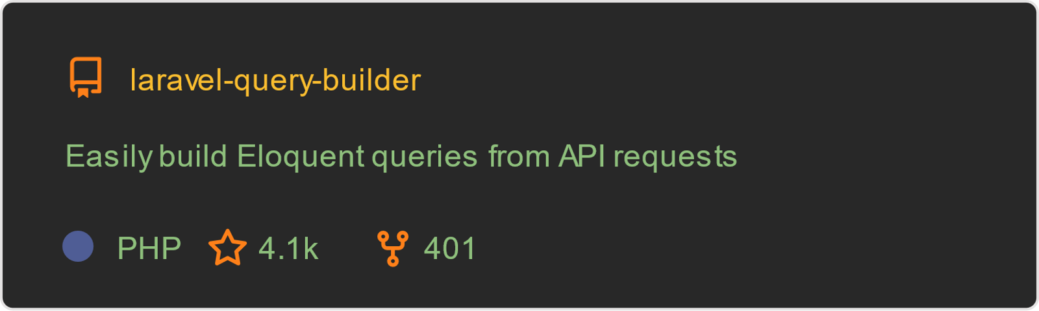

Slide 6


Slide 7


Slide 8
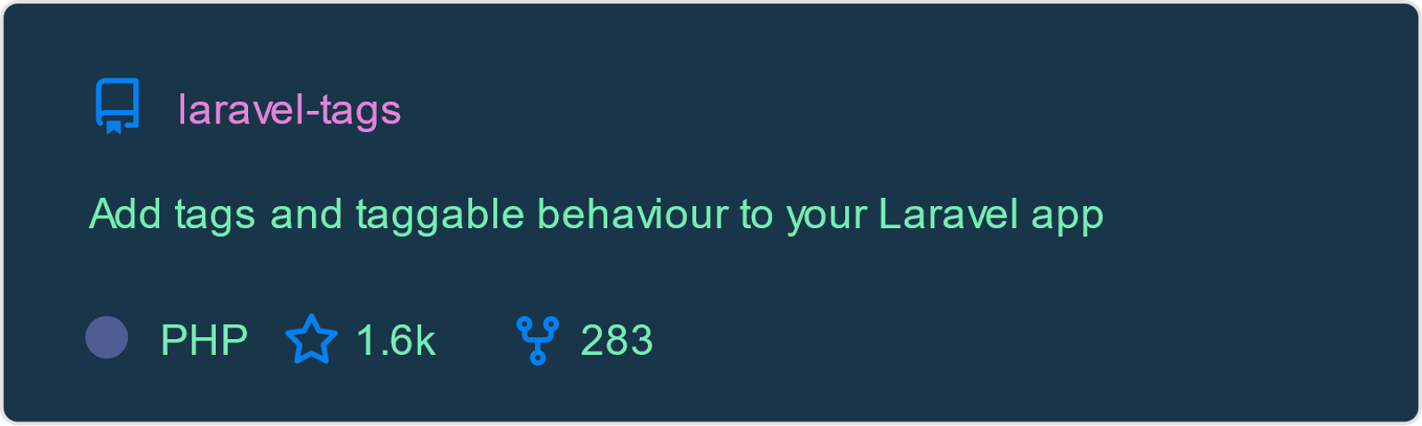

Slide 9


Slide 10


Slide 11


Slide 12


Slide 13


Slide 14


Slide 15
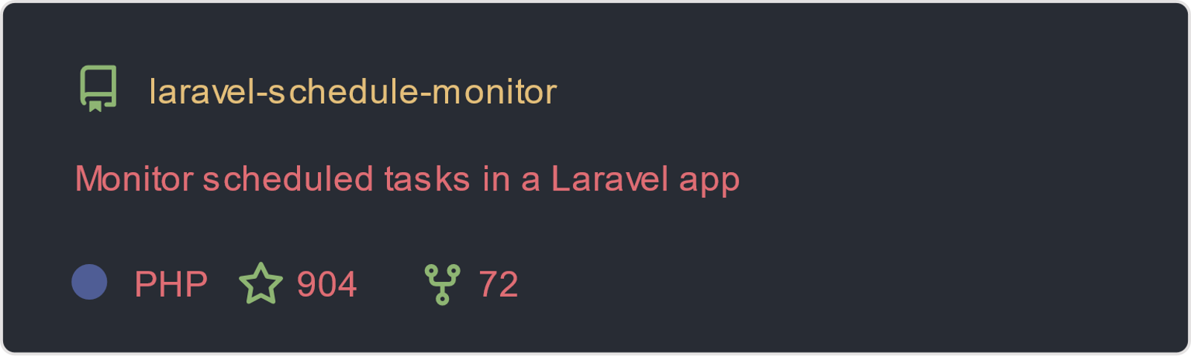

Slide 16
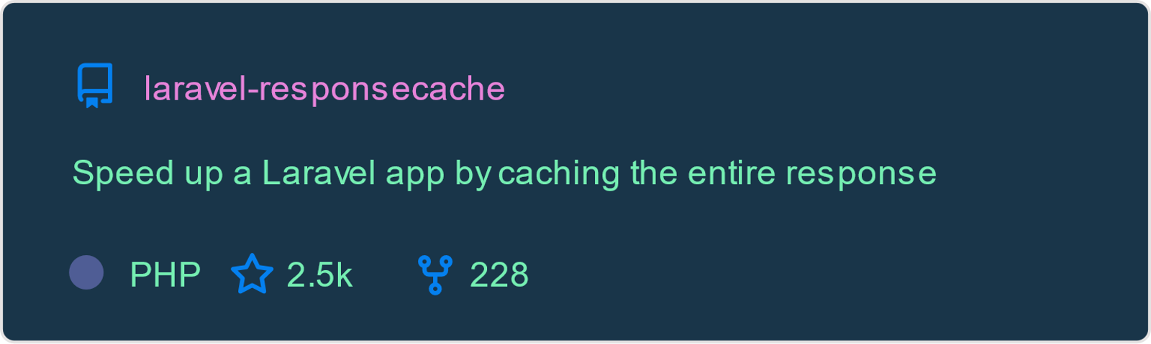

Slide 17


Slide 18


Slide 19
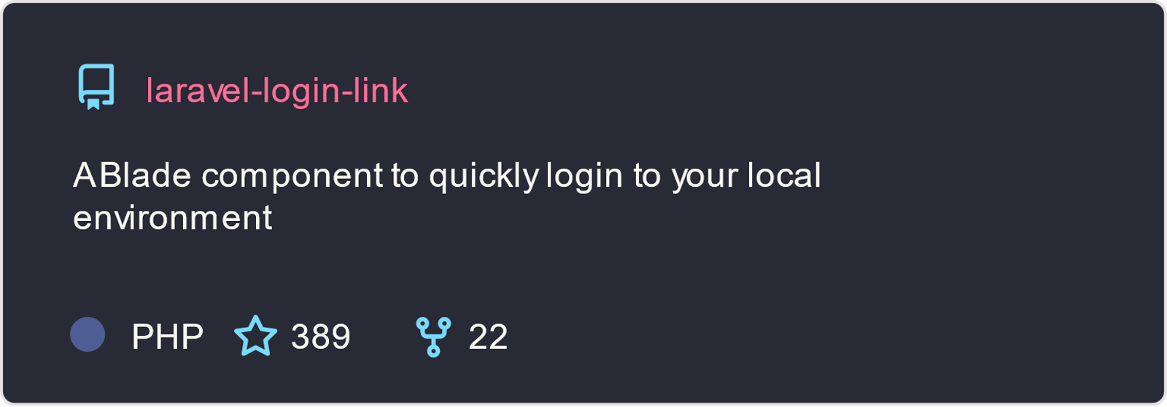

Slide 20
